Slide 1
AMA Integration
(American Medical Association)

Slide 2
Doctor Finder
What is Doctor Finder?
Doctor Finder is one of the application of AMA that is used to find the basic professional information of the physicians who are licensed in United States.
Detailed information is present in the application of the physicians who are associated with AMA.
Details of the physicians can be searched by both Physicians as well as Patients.
AMA DoctorFinder includes more than 814,000 AMA member and non-member doctors of medicine (MD) and doctors of osteopathy or osteopathic medicine (DO).

Slide 3
Doctor can change their profile detail by either going into Online Data Collection Center and updating the information or can directly update the data from the application itself.
Doctor can be searched by searching either by the specialty and name or practice location and name.

Slide 4
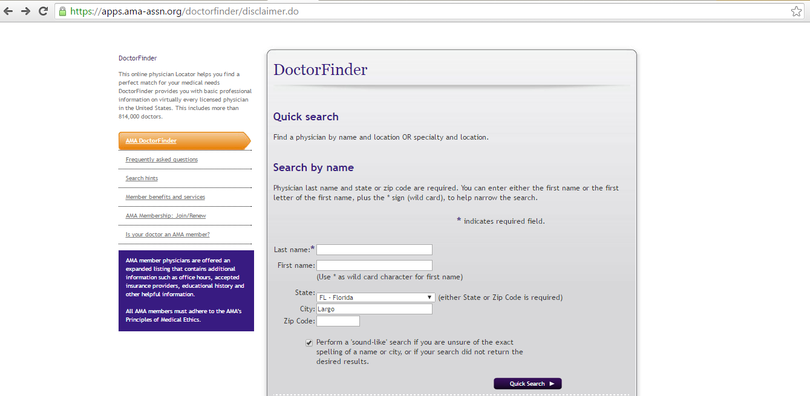
Search Doctor By Name

Slide 5
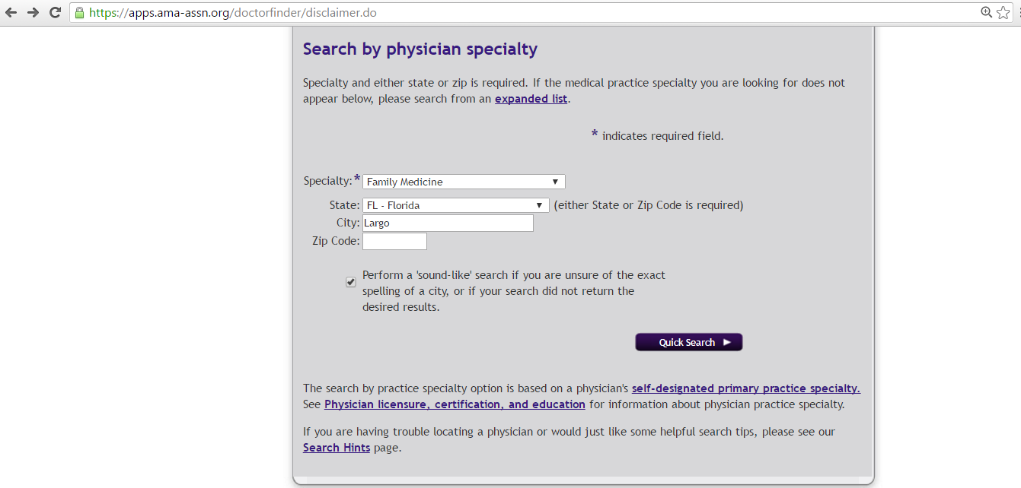
Search Doctor By Specialty

Slide 6
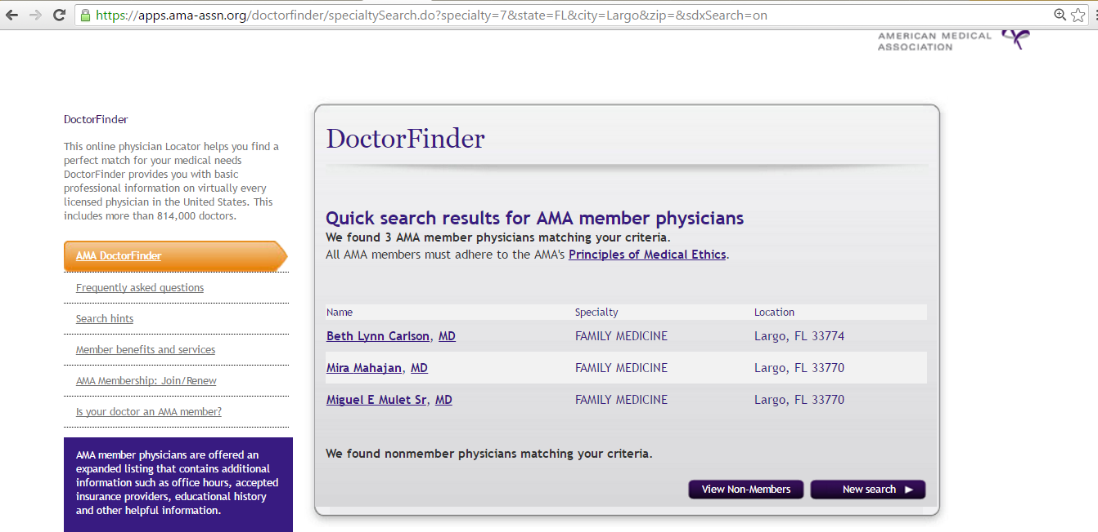
List of AMA Members searched

Slide 7
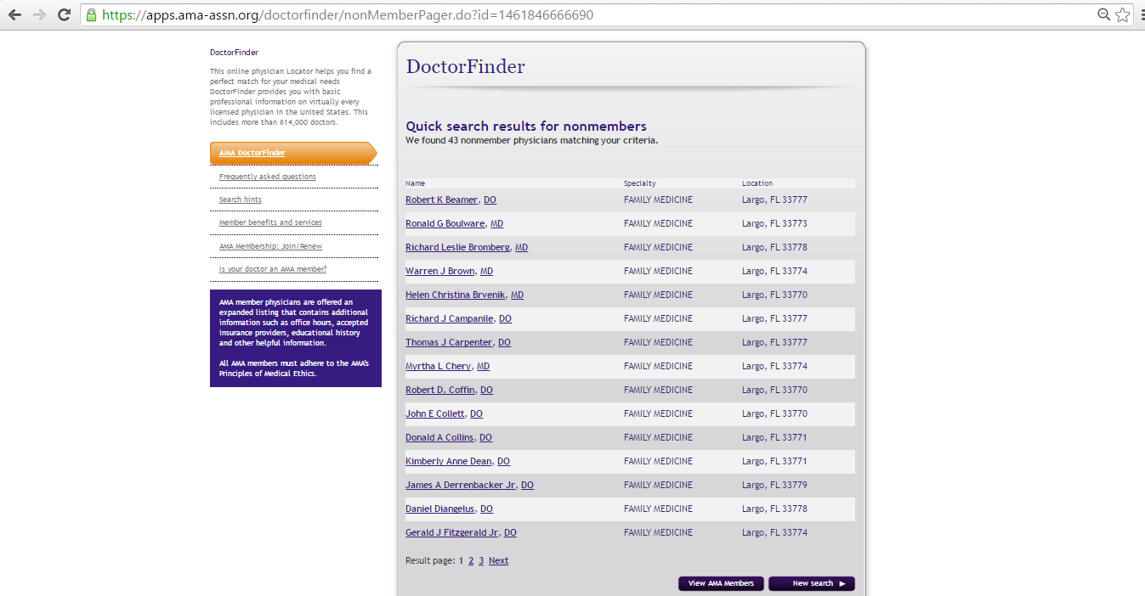
List of NON-AMA Members searched

Slide 8
AMA Apps
CPT E/M Quick Reference App.
AMA Grassroots.
My Medications.

Slide 9
CPT E/M Quick Reference App.
CPT® E/M Quick Reference is a fast and reliable reference guide that helps you easily determine the appropriate CPT Evaluation and Management (E/M) billing codes.
CPT® E/M Quick Reference is available for the Apple iPhone®, iPad® and iPod Touch® on the AMA iTunes store.

Slide 10
AMA Grassroots
The AMA Grassroots app provides advocates with tools to engage and influence elected officials on Capitol Hill and at home in their legislative districts on issues affecting health care.
The app empowers activists with an interactive legislative directory, built-in email and phone action alert tool, talking points and social engagement tools.

Slide 11
My Medications
With My Medications patients can store, carry and share their critical medical information (i.e. medications, allergies, emergency contacts, etc.) in one secure place.
My Medications is available for the Apple iPhone®, iPad® and iPod Touch® on the AMA iTunes store.

Slide 12
Thankyou

